Slide 1

maxima and minima , OPTIMIZATION
Prepared by
Md Saif Kabir
Lecturer,OAA

Slide 2
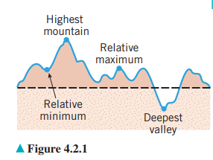
Relative maxima and minima

Slide 3
Critical Points
f ’(x)=0
Stationary Point
f ’(x)=undefined
Only Critical point

Slide 4
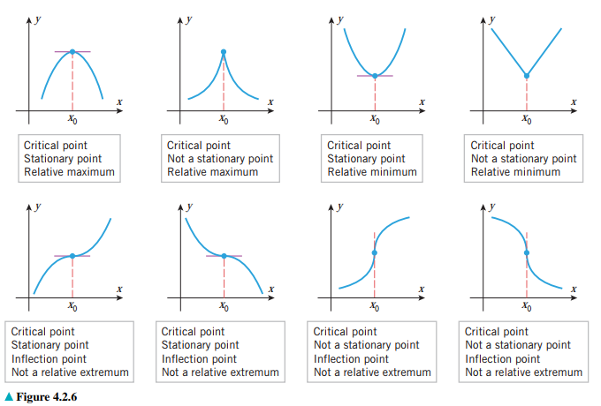

Slide 5
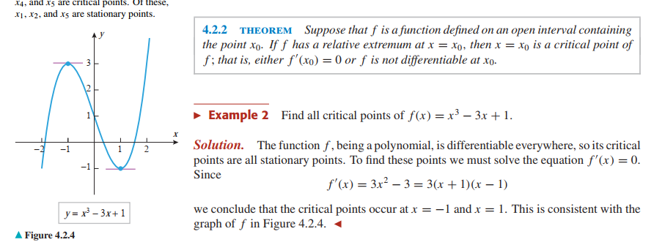

Slide 6
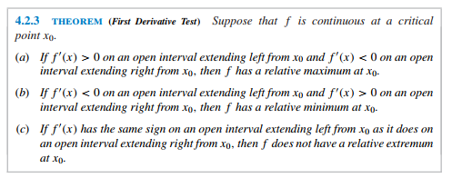
1st derivative test

Slide 7
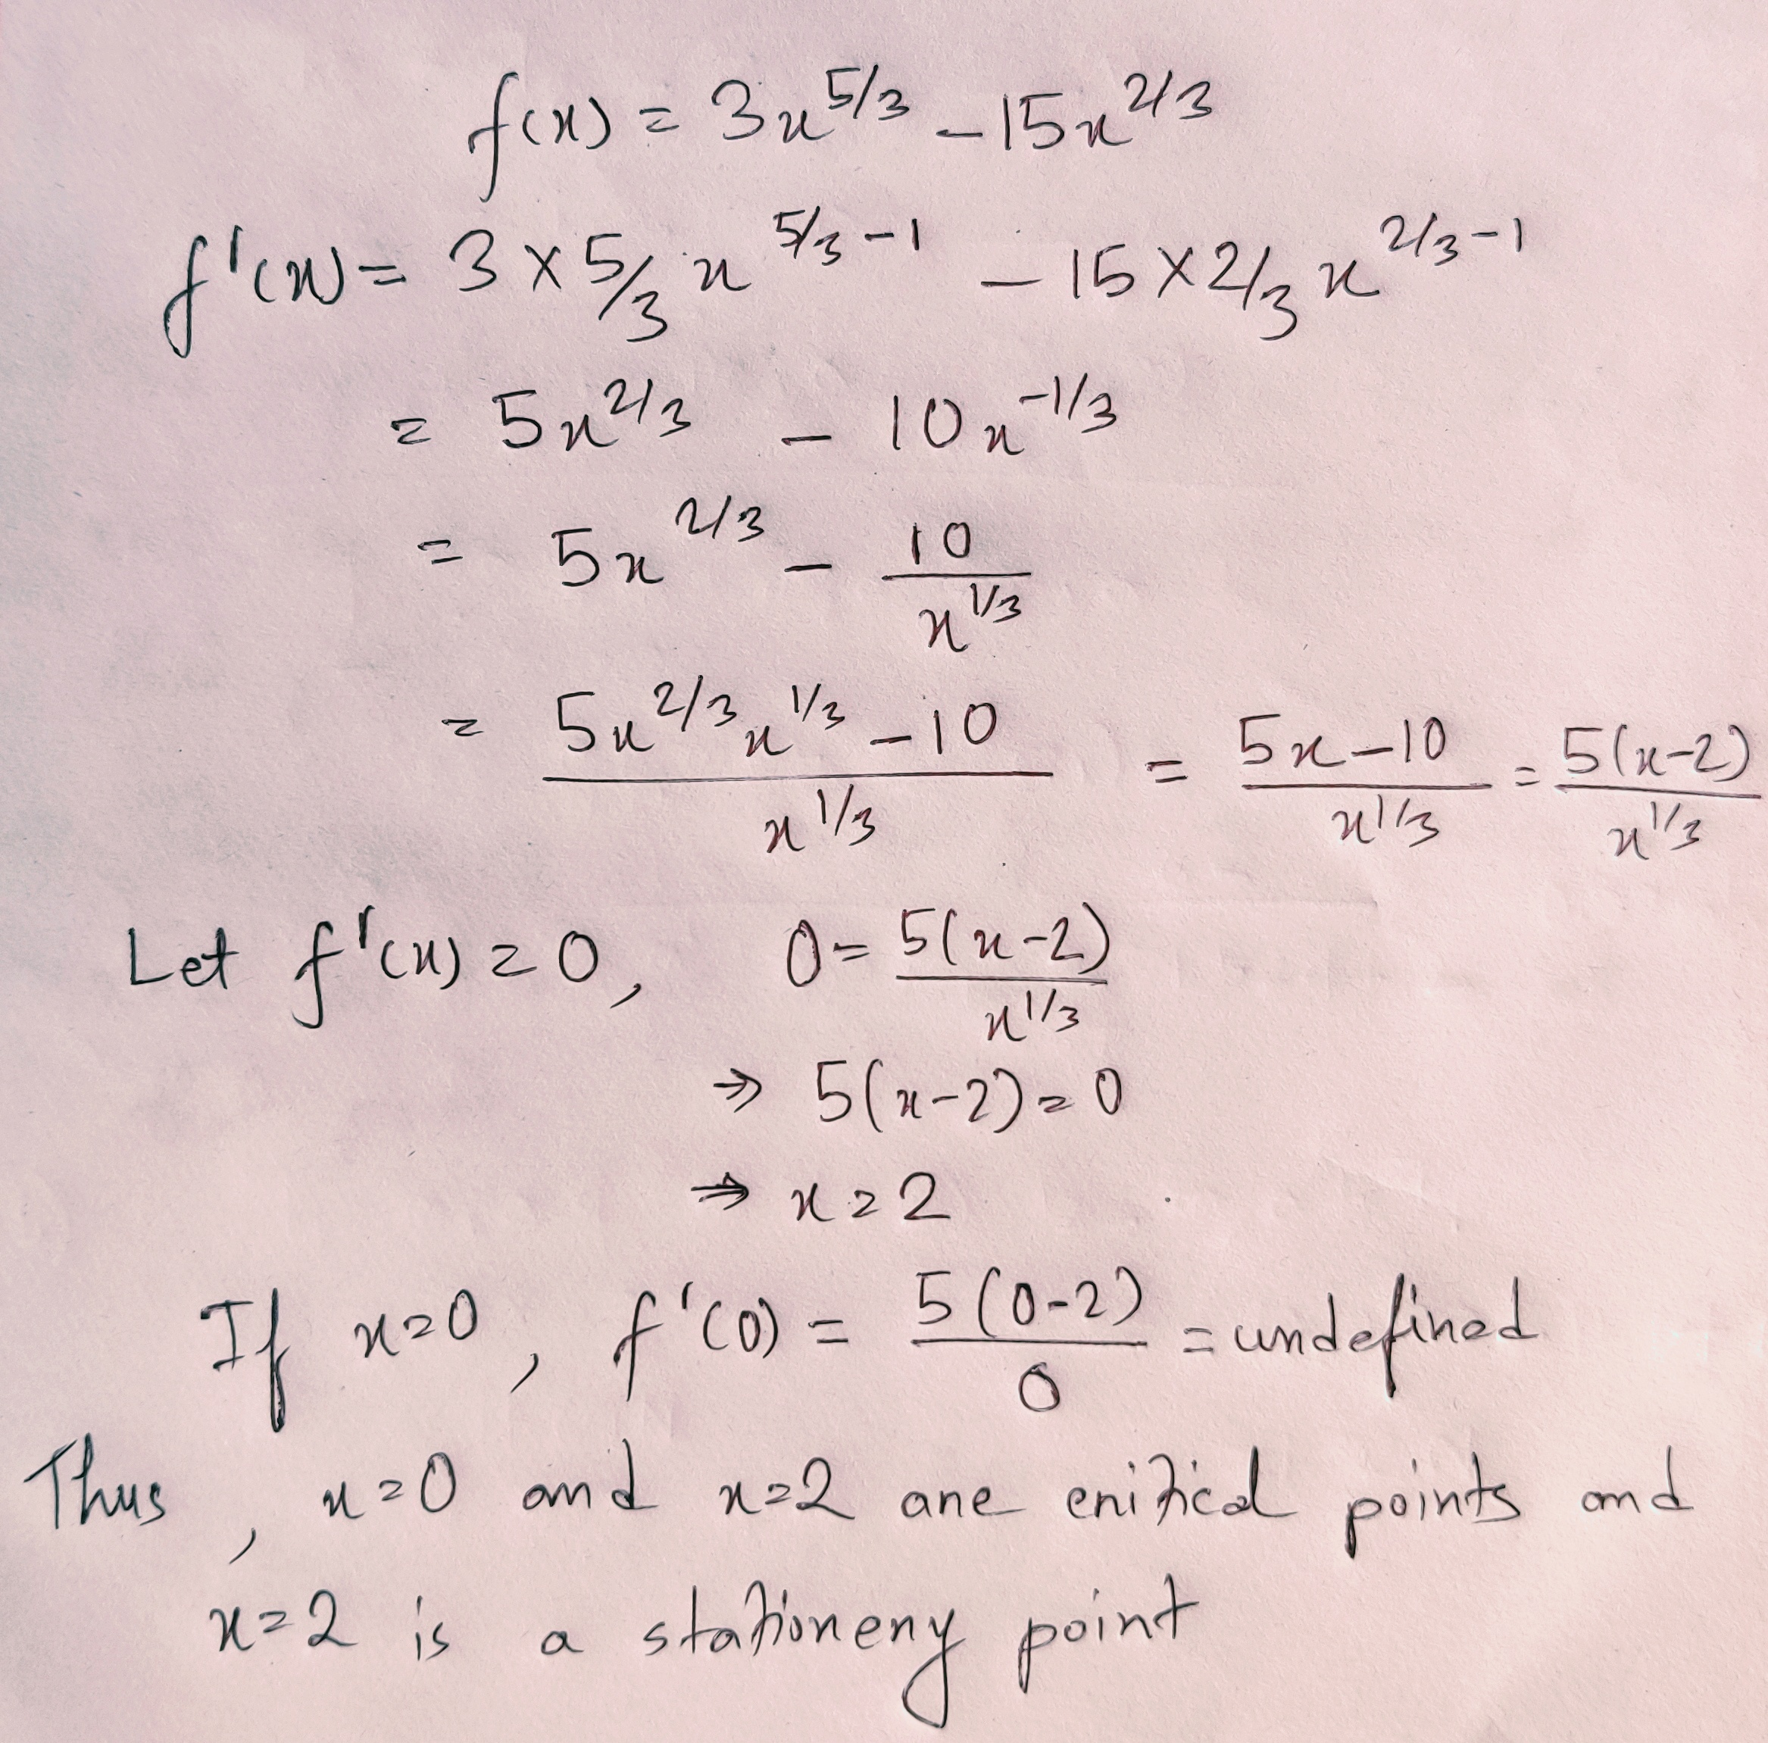

Slide 8
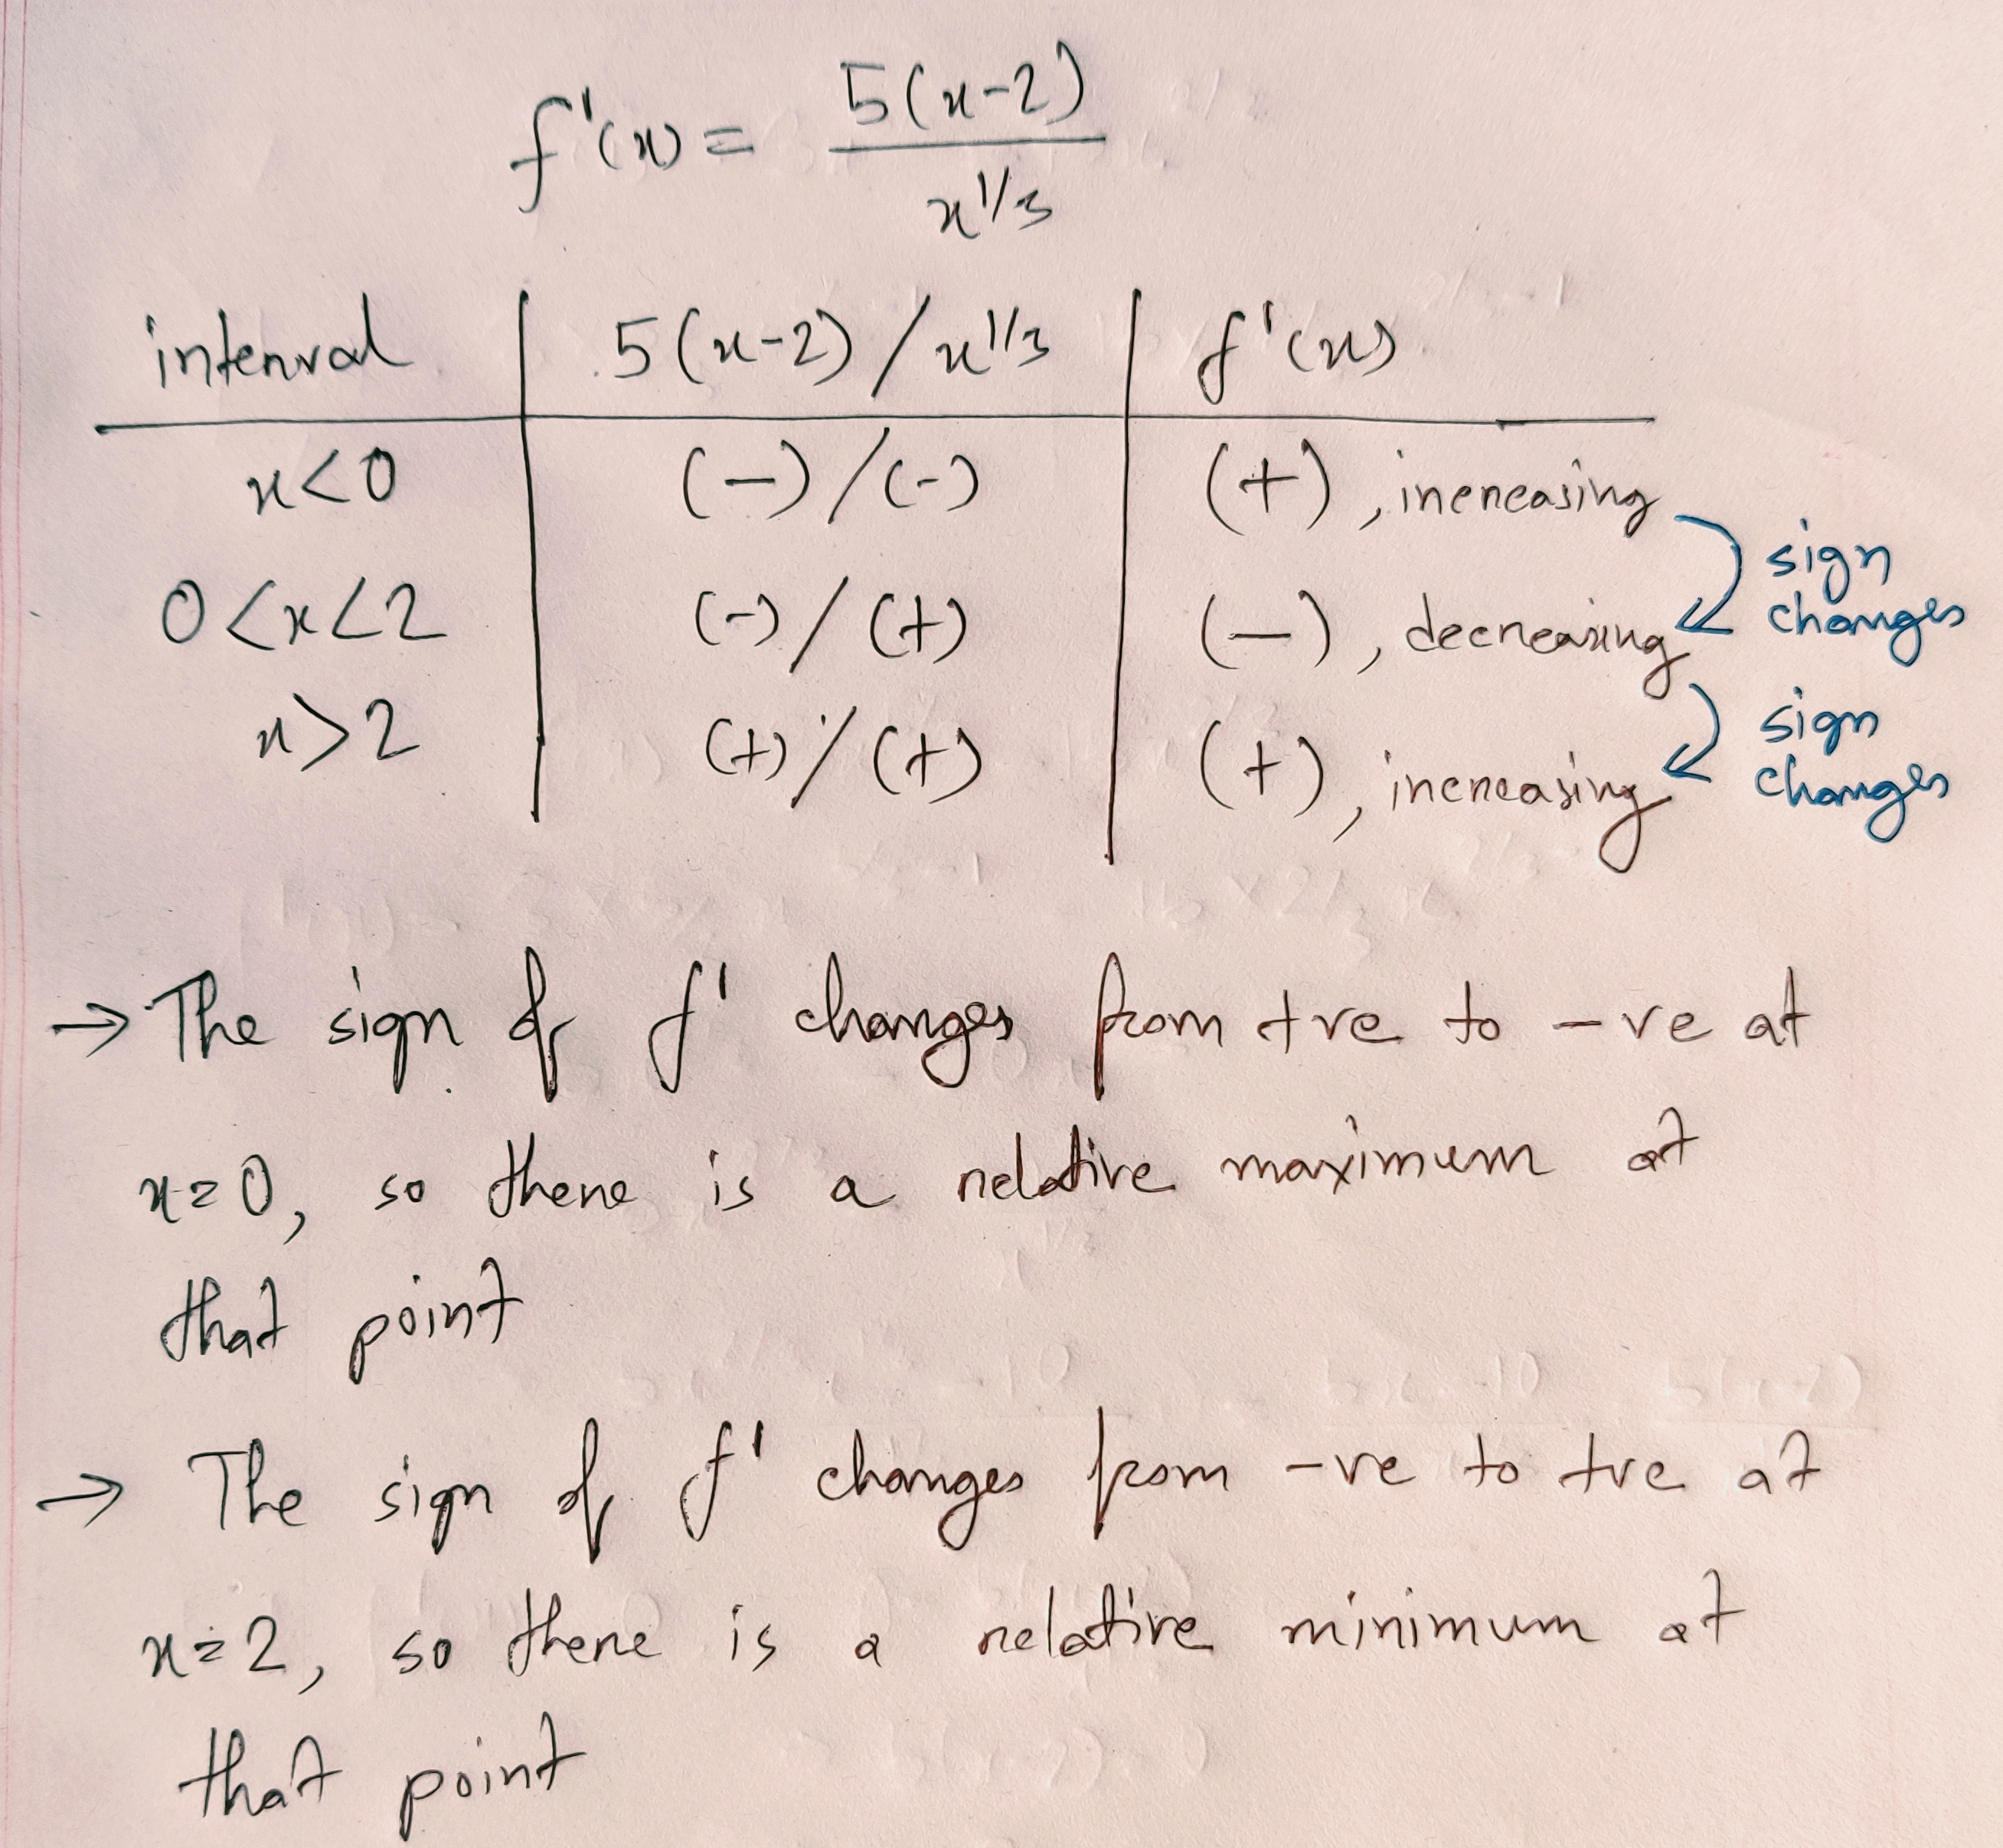

Slide 9
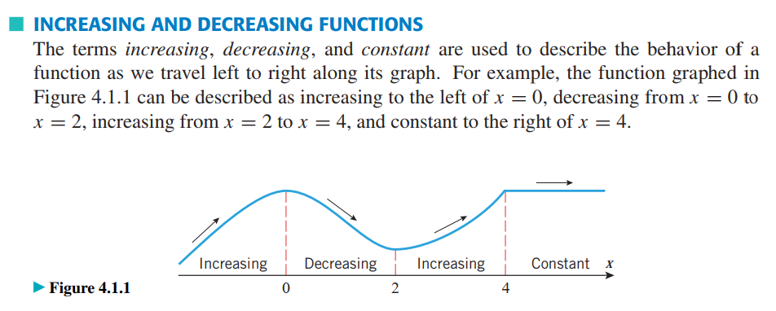

Slide 10
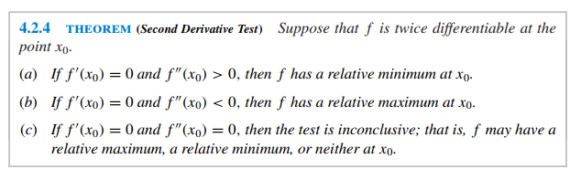
2nd derivative test

Slide 11
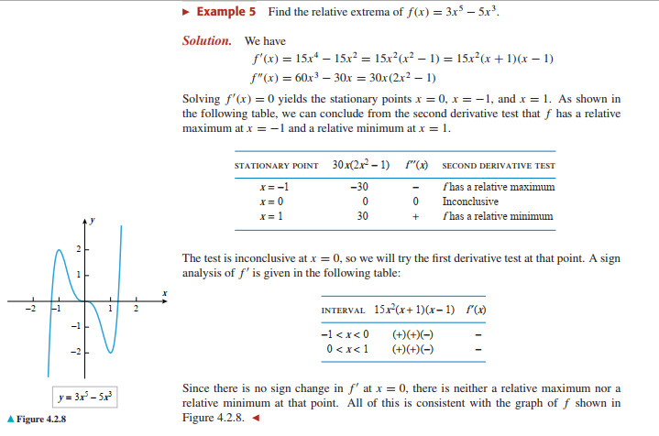

Slide 12

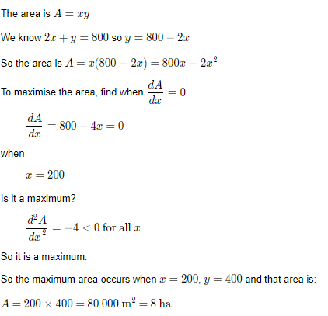
OPTIMIZATION
A rectangular storage area is to be constructed along the side of a tall building. A security fence is required along the remaining 3 sides of the area. What is the maximum area that can be enclosed with 800 m of fencing?

Slide 13
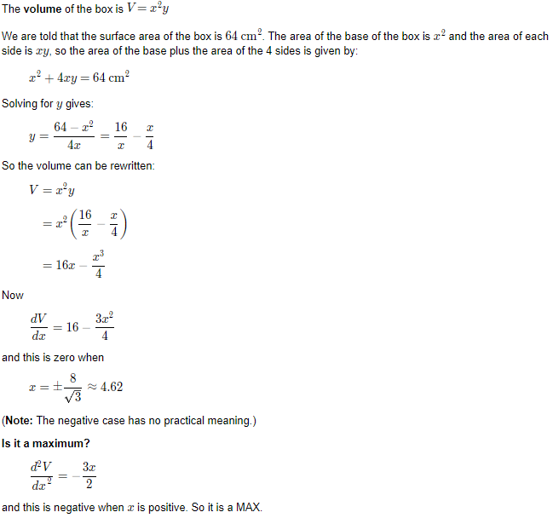
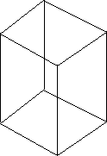
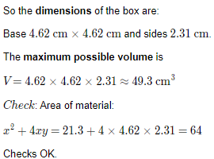
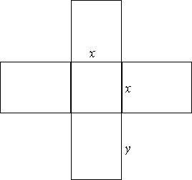
A box with a square base has no top. If 64 cm² of material is used, what is the maximum possible volume for the box?
The net for this box would be:

Slide 14
